Slide 1

RATIONMATE
SHIFANA NASRIN
MES24MCA-2052
Department of Computer Applications
MES College of Engineering, Kuttippuram
20-08-2025

Slide 2
PRODUCT OWNER MRS.RESHMI K ASSISTANT PROFESSOR DEPARTMENT OF COMPUTER APPLICATIONS MES COLLEGE OF ENGINEERING, KUTTIPPURAM

Slide 3
TABLE OF CONTENTS
Introduction
Objective
Existing System
Proposed System
Motivation
Functionalities
Module Description
Developing Environment
Sprint Backlog
Product Backlog
User Story
Project Plans
Data Flow Diagrams
ER Diagram

Slide 4
RATIONMATE
Mobile app for ration card holder in Kerala.
Tracks monthly ration entitlements.
Sends notifications for special schemes like Onam kit.
Displays shop open/closed status for the day
Support Malayalam and English
Work offline for rural accessibility.

Slide 5
OBJECTIVES
Display user’s monthly ration items and quantites.
Notify about special government schemes.
Show shop availability
Multilingual support
Enable offline access
Ensure timely,accurate update

Slide 6
EXISTING SYSTEM
Citizens must physically visit ration shop for update
No real-time scheme alerts
Information often delayed or unavaliable
Lack of awareness about entitlements
Complaint are difficult to manage

Slide 7
PROPOSED SYSTEM
Mobile app with ration details and alerts
Realtime scraping to fetch instant update from government portals.
Offline storage using SQLite database
Multilingual interface

Slide 8
MOTIVATIONS
Kerala’s public distribution system is a lifeline for many families.
Lack of timely accurate information cause frustration.
Citizens often travel to closed shop,waste time and resources.
Need for a reliable digital tool to bridge the information gap.

Slide 9
FUNCTIONALITIES
User Module
Login with mobile number or ration card
View card details and entitlements.
Monthly ration item list
Special scheme notification
Ration shop status
Submit complaints
Admin Module
Login
Post scheme alert
Update shop information
Manage complaints
Use real time scraping for automation

Slide 10
MODULE DESCRIPTION
User Module
Fetches data from ration database
Provides offline access.
Displays alerts in local language.
Admin Module
Updates scheme data.
Approves and resolves complaints.
Ensures users receive latest notifications.

Slide 11
DEVELOPING ENVIRONMENT
Operating System: Windows
IDE: Android Studio
Frontend: Android SDK (Kotlin/Java + XML)
Backend: Kotlin
Database: SQLite
Languages: English & Malayalam

Slide 12
SPRINT BACKLOG
Backlog tem | Status And Completion Date | Original Estimation in Hours | Day 1 hrs | Day 2 hrs | Day 3 hrs | Day 4 hrs | Day 5 hrs | Day 6 hrs | Day 7 hrs | Day 8 hrs | Day 9 hrs | Day 10 hrs
SPRINT1
UI mockup design | 10/08/2025 | 4 | 1 | 1 | 1 | 1 | 0 | 0 | 0 | 0 | 0 | 0
Login System implemention | 20/08/2025 | 6 | 1 | 1 | 1 | 1 | 1 | 1 | 0 | 0 | 0 | 0
Ration item list feature | 18/09/2025 | 6 | 1 | 1 | 1 | 1 | 1 | 1 | 0 | 0 | 0 | 0
SPRINT 2
Special scheme notification | 10/10/2025 | 6 | 1 | 1 | 1 | 1 | 1 | 1 | 0 | 0 | 0 | 0
Realtime scraping | 12/10/2025 | 7 | 1 | 1 | 1 | 1 | 1 | 1 | 1 | 0 | 0 | 0

Slide 13
SPRINT BACKLOG
Backlog tem | Status And Completion Date | Original Estimation in Hours | Day 1 hrs | Day 2 hrs | Day 3 hrs | Day 4 hrs | Day 5 hrs | Day 6 hrs | Day 7 hrs | Day 8 hrs | Day 9 hrs | Day 10 hrs
SPRINT3
Offline data storage | 12/10/2025 | 6 | 1 | 1 | 1 | 1 | 1 | 1 | 0 | 0 | 0 | 0
Shop status feature | 12/10/2025 | 6 | 1 | 1 | 1 | 1 | 1 | 1 | 0 | 0 | 0 | 0
SPRINT 4
Admin panel alerts | 16/10/2025 | 4 | 1 | 1 | 1 | 1 | 0 | 0 | 0 | 0 | 0 | 0
Complaint managment | 16/10/2025 | 5 | 1 | 1 | 1 | 1 | 1 | 0 | 0 | 0 | 0 | 0
Testing and bug fixes | 16/10/2025 | 7 | 1 | 1 | 1 | 1 | 1 | 1 | 1 | 0 | 0 | 0
TOTAL |  | 57 | 11 | 11 | 11 | 11 | 9 | 8 | 2 | 0 | 0 | 0

Slide 14
PRODUCT BACKLOG
ID | NAME | PRIORITY <high/medium/low> | ESTIMATE (Hours) | STATUS <Planned/In progress/Completed>
1 | User registration and login | High | 8 | Completed
2 | View card details | High | 5 | In progress
3 | Monthly ration item list | High | 10 | In progress
4 | Special scheme notification | High | 10 | planned
5 | Ration shop status | High | 8 | planned
6 | Complaint submission | Medium | 6 | Planned
7 | Admin alert management | High | 10 | In progress

Slide 15
PRODUCT BACKLOG
ID | NAME | PRIORITY <high/medium/low> | ESTIMATE (Hours) | STATUS <Planned/In progress/Completed>
8 | Admin holiday | Medium | 6 | planned
9 | Admin complaint review | Medium | 6 | Planned
10 | Multilingual support | Medium | 12 | In progress
11 | Offline mode implementation | High | 15 | In progress

Slide 16
USER STORY
User Story ID | As a type of User | I want to <Perform some task> | So that i can <Achieve Some Goal>
1 | User | Register/Login | Access my account securely
2 | User | View card and details | See card type and member
3 | User | View monthly list | Track my ration item
4 | User | Get scheme alerts | Know about special benefit
5 | User | Check shop status | Avoid waste trip
6 | User | Submit complaint | Report issue early

Slide 17
USER STORY
User Story ID | As a type of User | I want to <Perform some task> | So that i can <Achieve Some Goal>
7 | Admin | Post Alert | Inform all users
8 | Admin | Manage holidays | Keep shop information update
9 | Admin | Review Complaints | Resolve user problem
10 | User and Admin | Use Malayalam and English | Use preferred language
11 | User | Use offline mode | Access without internet
12 | Admin | Login | Securely access panel

Slide 18
PROJECT PLAN
User StoryID | Task Name | Start Date | End Date | Days | Status
1 | Sprint 1 | 10/08/2025 | 12/08/2025 | 12 | In progress
2 |  | 13/07/2025 | 16/08/2025 |  | In progress
4 |  | 16/08/2025 | 18/08/2025 |  | In progress
10 |  | 20/08/2025 | 22/08/2025 |  | planned
11 |  | 23/08/2025 | 25/08/2025 |  | planned
2 | Sprint 2 | 29/08/2025 | 30/08/2025 | 17 | Planned
5 |  | 31/08/2025 | 01/09/2025 |  | Planned
6 |  | 02/09/2025 | 06/09/2025 |  | Planned

Slide 19
PROJECT PLAN
User StoryID | Task Name | Start Date | End Date | Days | Status
7 | Sprint 3 | 19/09/2025 | 22/09/2025 | 8 | Planned
8 |  | 23/09/2025 | 26/09/2025 |  | Planned
9 | Sprint 4 | 11/10/2025 | 14/10/2025 | 6 | Planned
10 |  | 15/10/2025 | 16/10/2025 |  | Planned

Slide 20
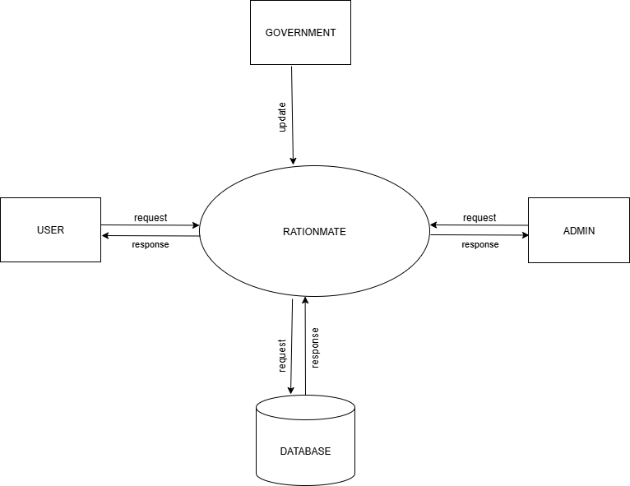
DATA FLOW DIAGRAM
LEVEL 1

Slide 21
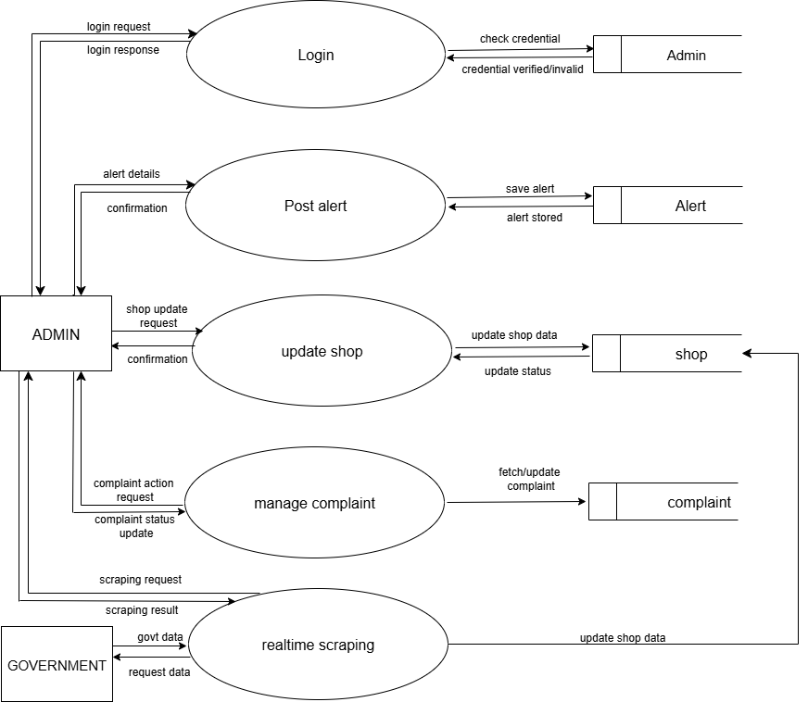
DATA FLOW DIAGRAM
Level 1.1

Slide 22
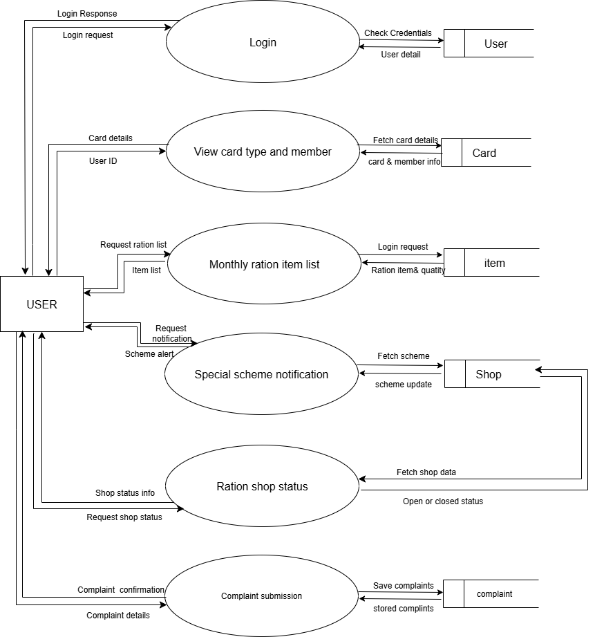
DATA FLOW DIAGRAM
Level 1.2

Slide 23
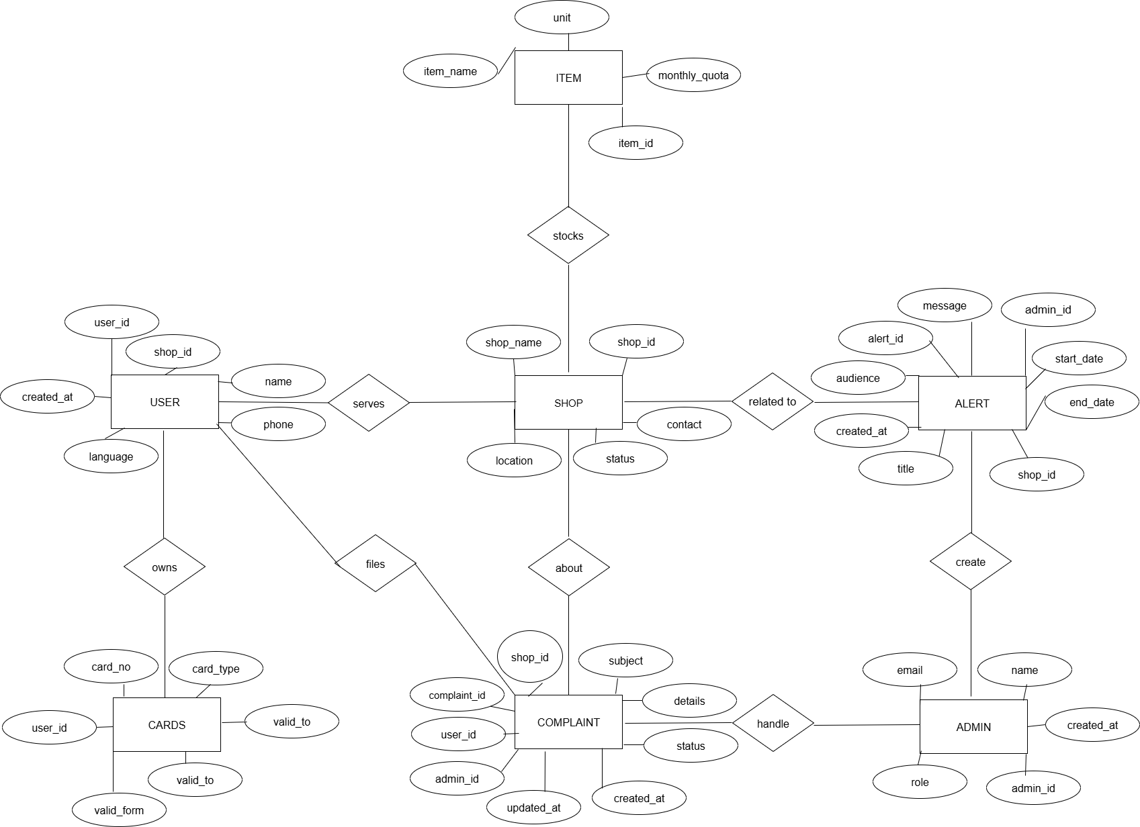
ER DIAGRAM

Slide 24
THANK YOU

